Slide 1
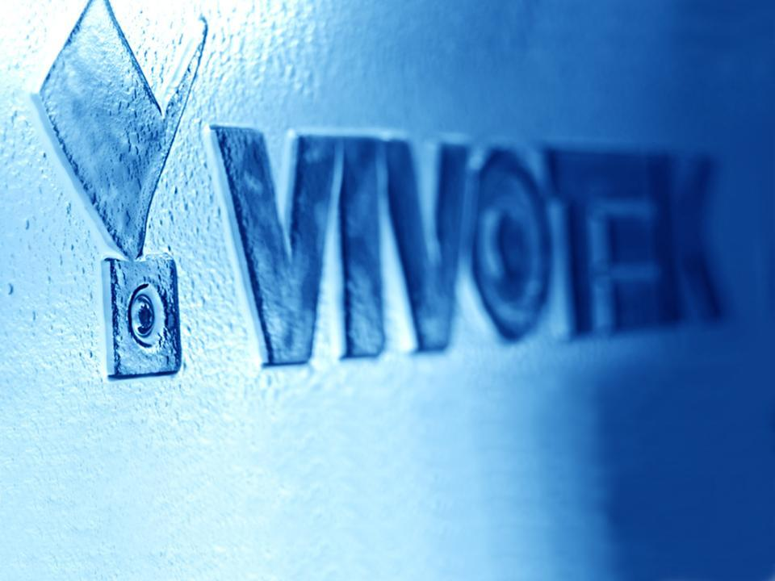
IP8371E Product Change Announcement
Notes:
1

Slide 2
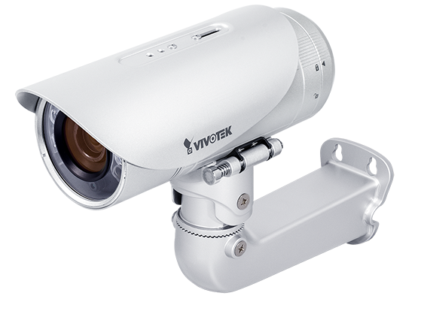
IR-LED Change
Purpose
OSRAM IR LED is more stable and provide better lighting performance
Adopting OSRAM IR LED on IP8371E to ensure better IR performance without increasing price/ cost
Notes:
2

Slide 3
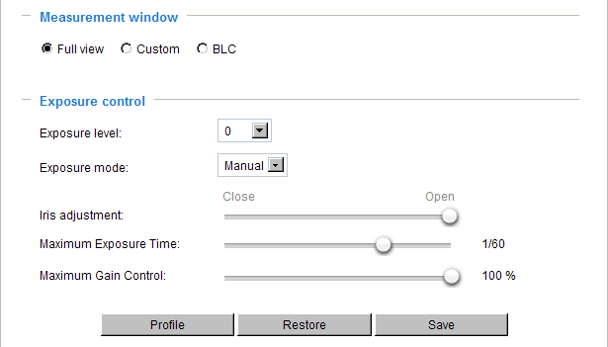
IR-LED Change
Measurement Test
Gain: Auto
Notes:
3

Slide 4
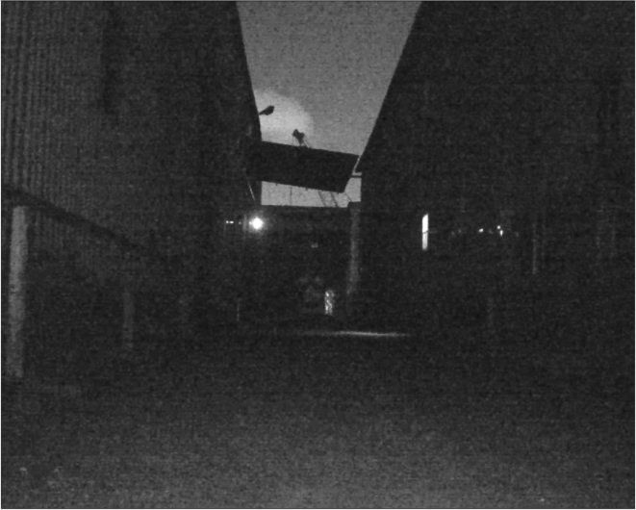
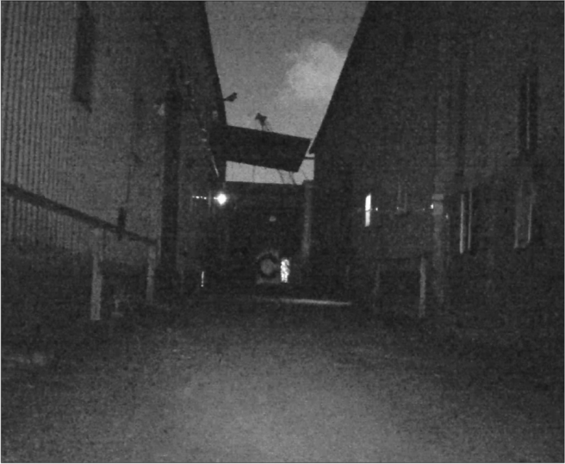
IR-LED Change -- Performance
IR Performance Improved : Tele
Original : IRE 20
New : IRE 33
Notes:
4

Slide 5
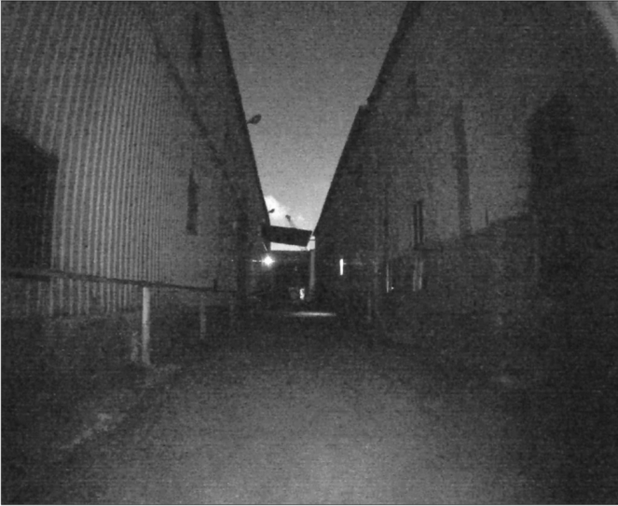
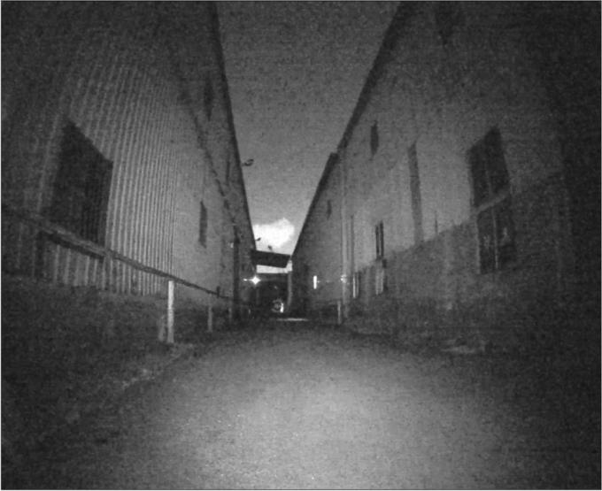
IR-LED Change -- Performace
IR Performance Improved : Wide with Noise Filter Off
Original : IRE 30
New : IRE 44
Notes:
5

Slide 6
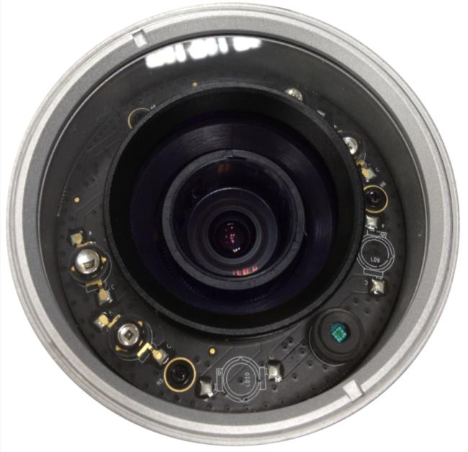
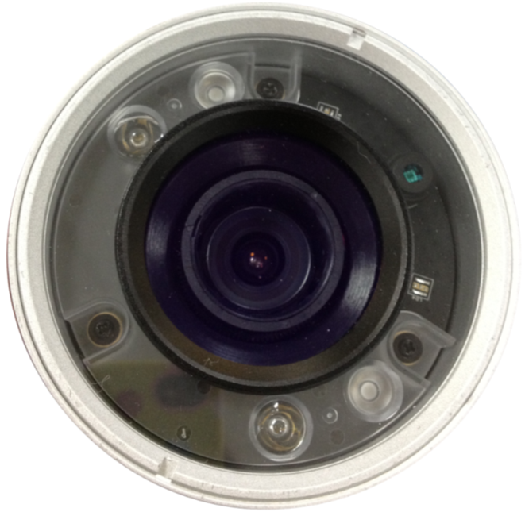
IR LED Change -- Outlook
Original Outlook
New Outlook
Notes:
6

Slide 7
Thank you
for your attention
The End
Notes:
7

